Slide 2

SPECIES RECOGNITION
FROM POLLEN IMAGE
VU THANH HANG – 20224310
NGUYEN HA ANH - 20224298

Slide 3
CONTENTS
Introduction
Method
Dataset
Conclusion & Future Work

Slide 4
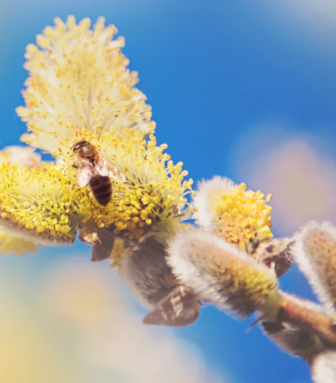
Introduction
What is pollen?
Pollen is a substance produced by flowering plants, trees, grasses, and weeds to fertilize other plants of the same species

Slide 5
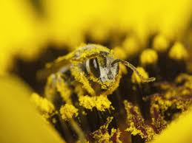
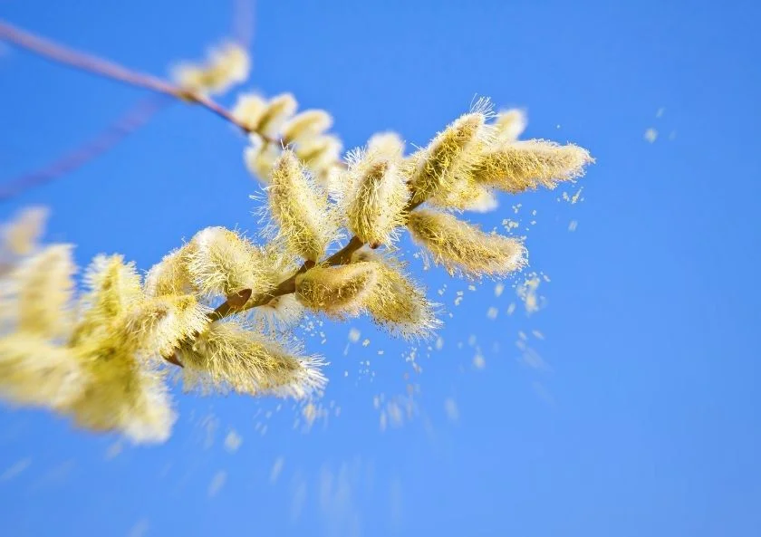
Introduction
Why pollen classification?
Accurate identification of pollen species is essential in ecology, agriculture, forensics and allergen studies.
Automated recognition of pollen species help saving time and increase accuracy.

Slide 6
Introduction
Desired outcome
Input : pollen image
Output : species name
Challenges
High variability in appearance and inter-class similarity:
Limited labeled data
Noisy image

Slide 7
Method
Data augmentation
DenseNet121

Slide 8
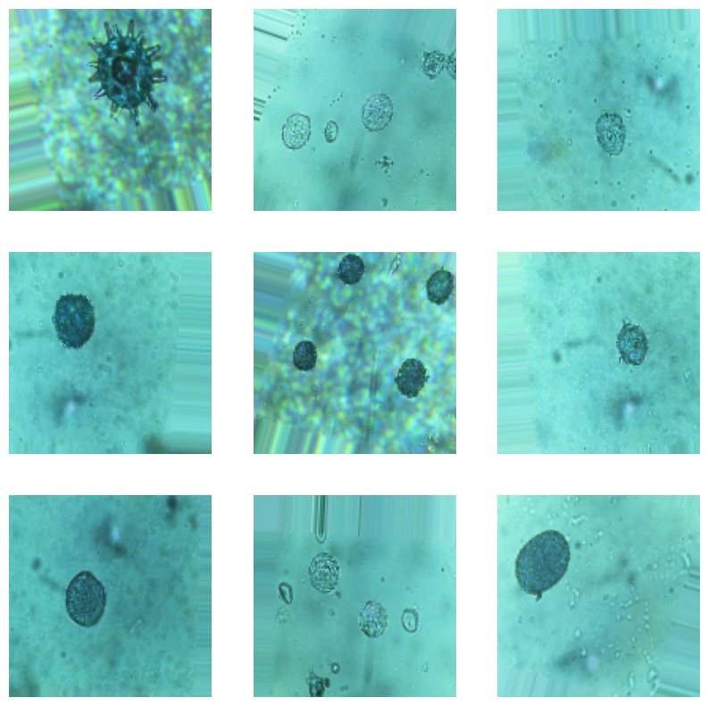
Method
Data augmentation
Generating new training images by applying transformations to existing ones (rotation, flipping…)

Slide 9
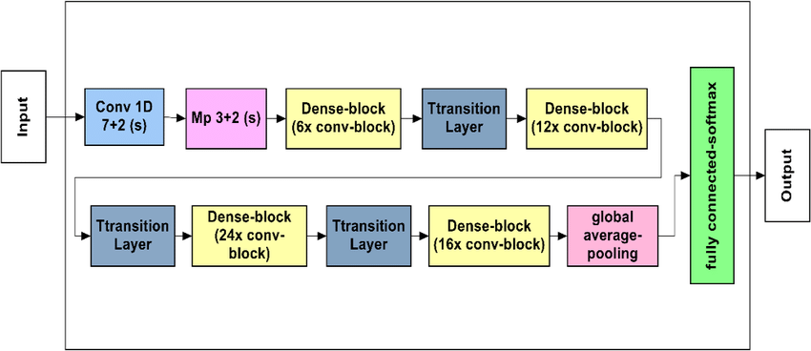
Method
DenseNet121
DenseBlock gets input from all previous layers
High performance with limited computational resources & small dataset

Slide 10
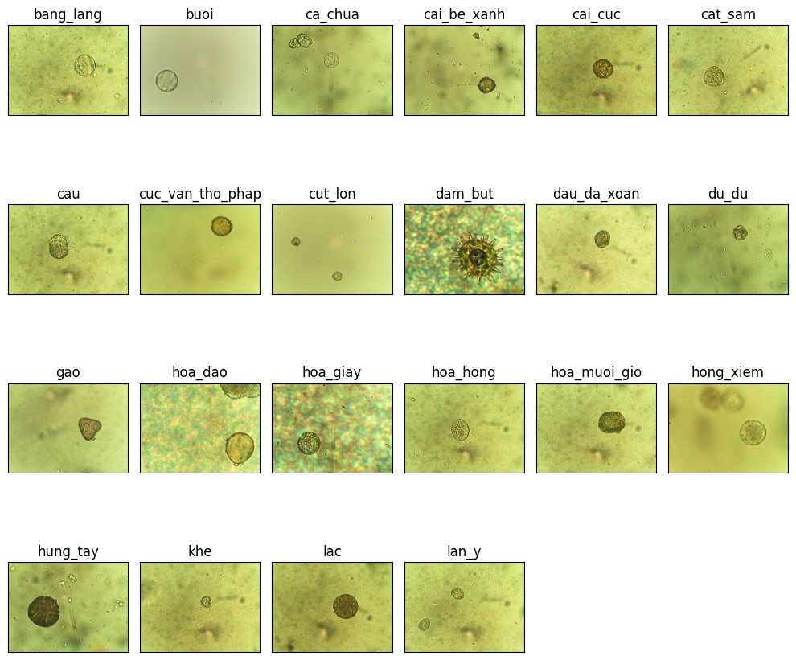
Dataset
Dataset
Pollen_VNUA subset
A dataset created by Vietnam National University of Agriculture
Subset of 22 species

Slide 11
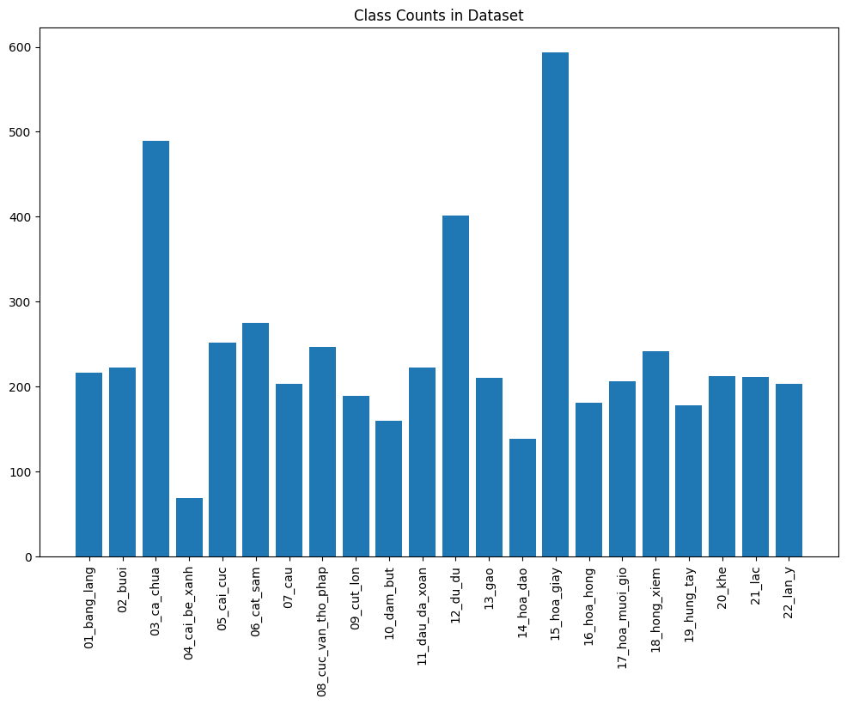
Dataset
Dataset
Highest: hoa giay
Lowest: cai be xanh

Slide 12
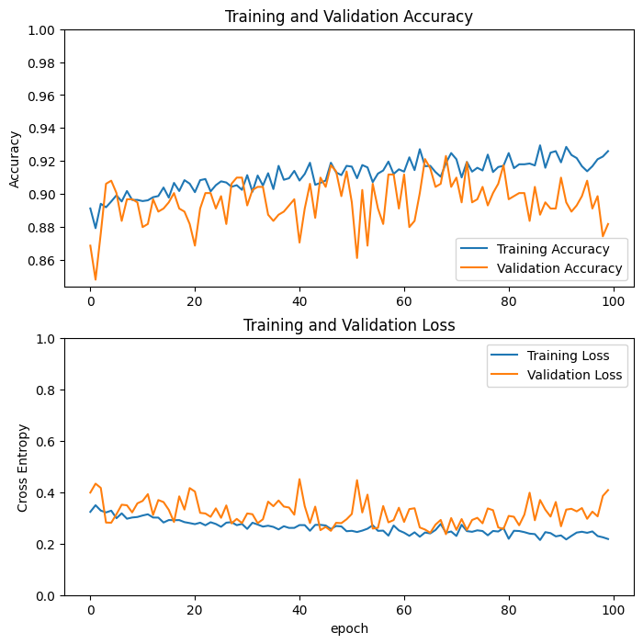
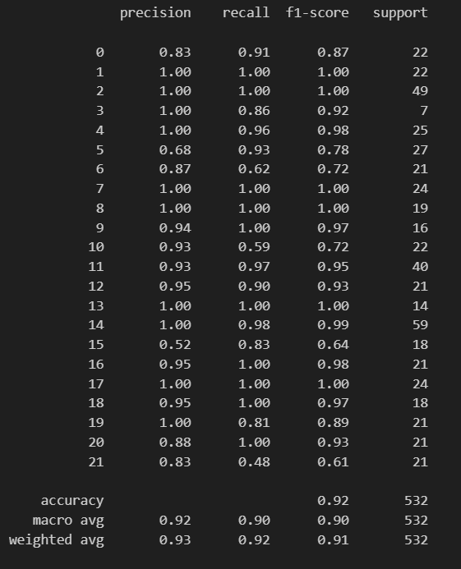
Experiment Result

Slide 13
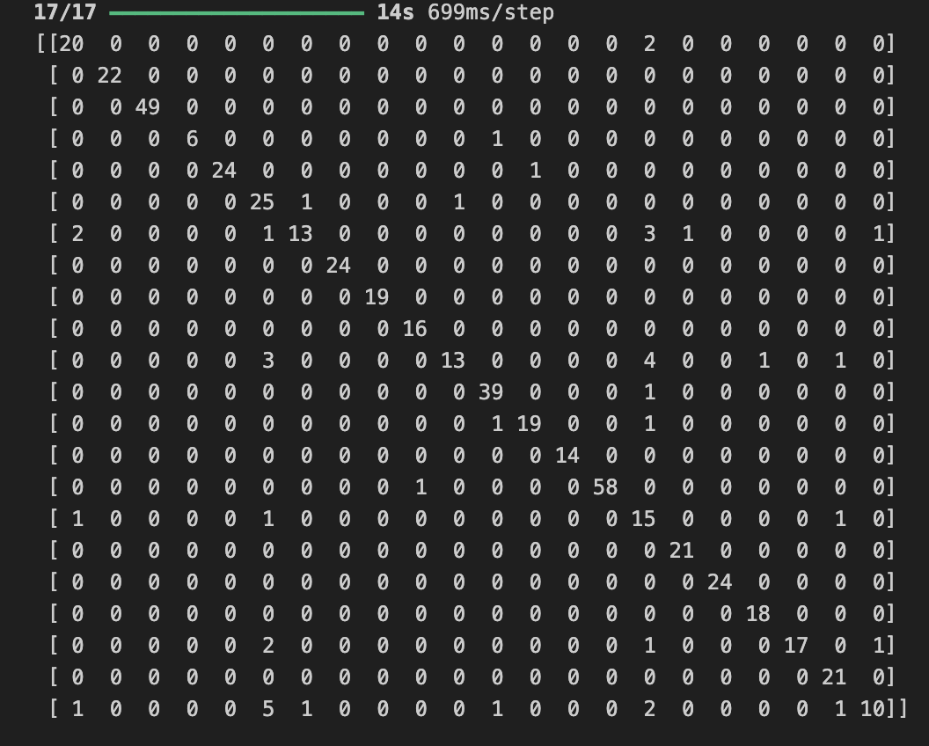
Experiment Result
Confusion Matrix

Slide 14
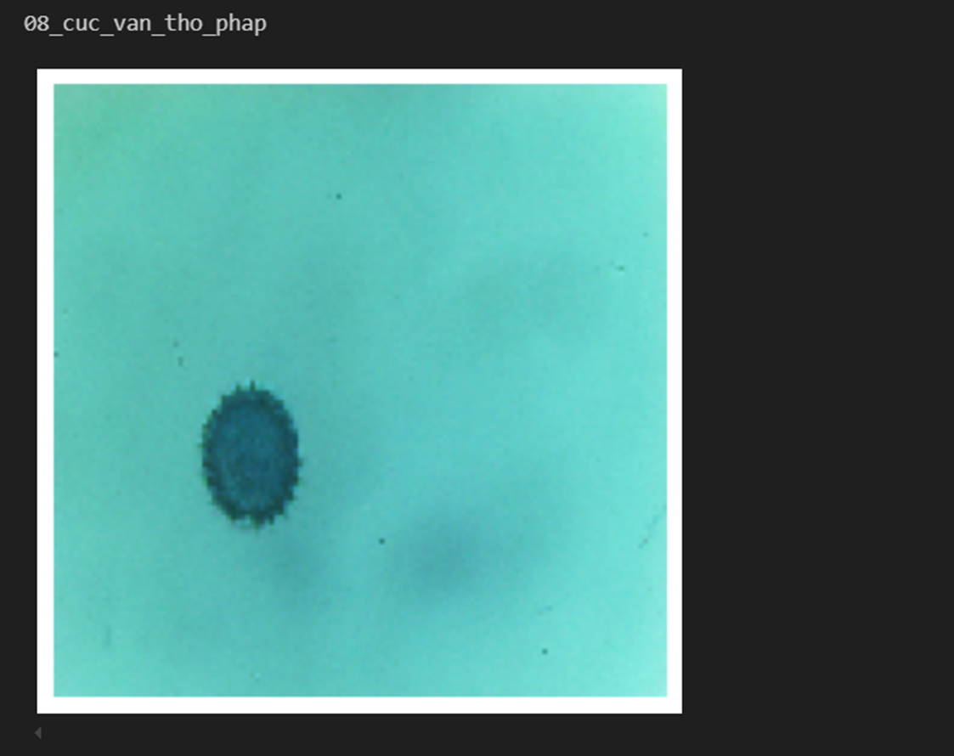
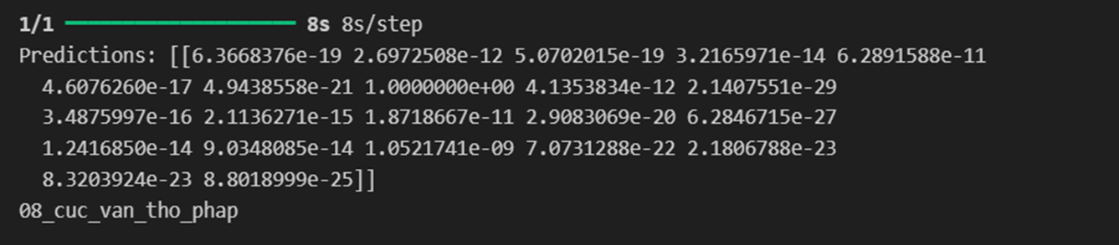
Experiment Result
Input in test set
Output of model

Slide 15
Conclusion & Future work
Project achievement
Developed an automated system for classifying pollen species using DenseNet121 and transfer learning.
Achieved 92% test accuracy despite limited data and inter-class similarity.
Optimized with data augmentation and dropout to prevent overfitting.
Future Work
Enhance preprocessing by isolating pollen grains and addressing noise.
Experiment with different architectures and hyperparameters to improve robustness.

Slide 16
THANK YOU !

